Slide 1
Capstone Project - The Battle of Dutch Cities
Applied Data Science Capstone Project by IBM/Coursera – I. Quint

Slide 2
Problem
Comparison of Dutch province capital cities
Rotterdam and Amsterdam do not fit this description, but are added to the sample
Comparison based on number of venues per 1,000 inhabitants

Slide 3
Data
List of capital cities per province (Wikipedia)
Number of inhabitants in the city (Wikipedia)
Venues in (capital) city (Foursquare API)
Exact city location (GPS coordinates)

Slide 4
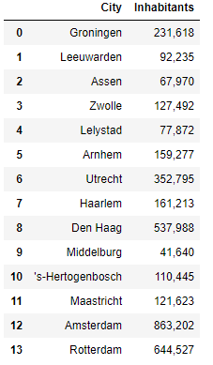
The cities within the sample and their numbers of inhabitants.

Slide 5
Methodology
Getting number of venues
Expressing this as a comparative measure
K-Means clustering algorithm

Slide 6
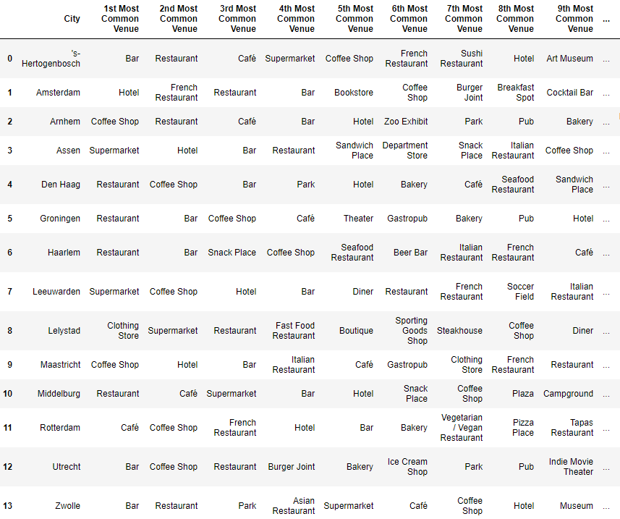
Analysis

Slide 7
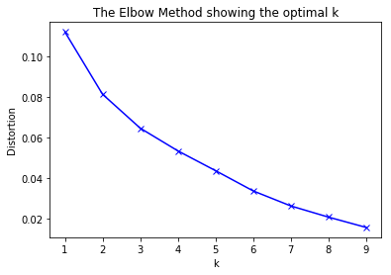
Finding optimal K

Slide 8
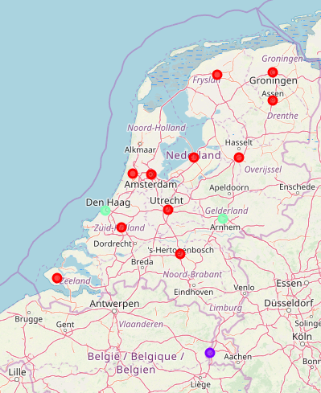
Map
3 clusters
The Hague and Arnhem form a separate cluster
Maastricht forms a separate cluster

Slide 9
Conclusion
3 clusters were found. Many cities comparable
Notably, Maastricht has its own cluster
Due to high number of coffee shops and hotels on a relatively low number of inhabitants.
Likely to occur due to tourism

